Slide 1

Class 11 - Pandas
[w200] MIDS Python Course

Slide 2
Agenda
Course Schedule Project 2 - Project Team Coordination (10 minutes) Data Exploration and Analysis Project 2 - Team Discussions (as time allows)
Remember the guides for Numpy and Pandas in our resources area:
NumPy
Pandas Review Sheet
See the various resources on GitHub!

Slide 3

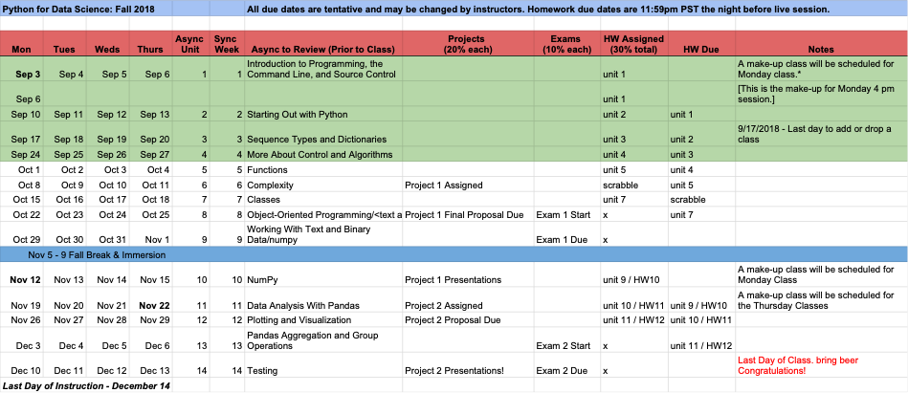
Schedule
https://docs.google.com/spreadsheets/d/1sVV7-4OHZ-EDNqkMJ55OPUfz_QLJ4LZNuZl-cRaxgV0/edit#gid=0

Slide 4
Schedule | Where we’re going - projects & exam
Discuss final project
Next week: Proposal finalized
Week 13: Final Exam distributed
Week 14: Final Exam is due; presentation showcase!

Slide 5
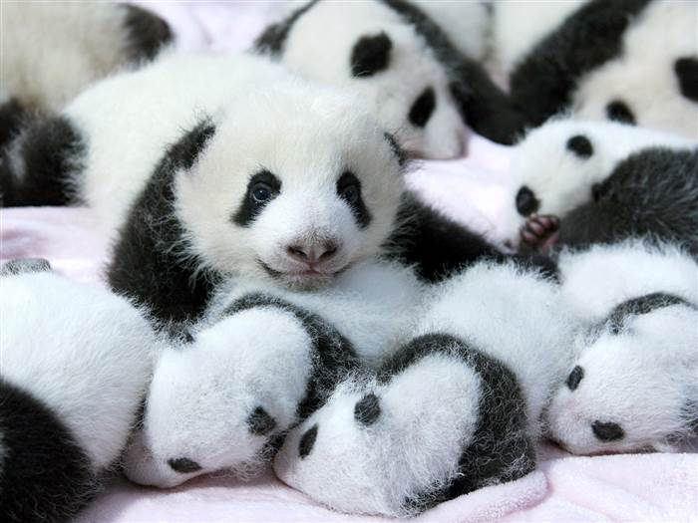
Schedule
Quick romp thru Pandas
Project 2
Your ideas
Chat among yourselves to create teams
Activities
Just FYI: here’s a 10 min guide… may help with tonight’s activities
https://pandas.pydata.org/pandas-docs/stable/10min.html
Optional! see https://www.tutorialspoint.com/python_pandas/python_pandas_visualization.htm

Slide 6
Assignment Review | NumPy
How did the homework go this week?
What was the hardest? What was easiest?

Slide 7
Agenda
Course Schedule Project 2 - Project Team Coordination (10 minutes) Data Exploration and Analysis Project 2 - Team Discussions (as time allows)

Slide 8
Project 2 | Grading
1-2 page proposal: 10% 8 page paper: 60% Final class presentation: 30%
Confidential peer review and task performance itemization
Instructions: https://github.com/UCB-INFO-PYTHON/assignments-instructors/blob/master/project_2/Project2Fall17.md
Teams: https://docs.google.com/spreadsheets/d/1BK1E7BxYBo5eVU2Vq7N6vOaKiWkZ8tRKdSukUWAp4KM/edit#gid=0

Slide 9
Project Breakouts
Talk with your team about your project
Create your team repository!
What do you hope to get out of the project?
When would you like to meet next?
Discussion

Slide 10
Agenda
Course Schedule Project 2 - Project Team Coordination (10 minutes) Data Exploration and Analysis Project 2 - Team Discussions (as time allows)

Slide 11
Data Analysis | Two Thoughts
Data Exploration Basics
Data Analysis Basics

Slide 12
http://www.byteorigin.com/services/cloud-application-development/big-data-analytics/

Slide 13
Data Analysis | Exploration vs. Analysis
Data Exploration
Used to ensure data integrity (what is data integrity?)
Develop questions based on the variables you have
Try to break things (better now than in production!)
Data Analysis
Seeks to answer a research question or hypothesis
May involve complex math, modeling, statistics
More likely to combine multiple dataset
Collapse and group data in various ways
Some functions are useful for both exploration and analysis!

Slide 14

Data Analysis | Data Exploration Basics
Real World Data Are Messy.
No, really. They’re very messy.
If anything can be wrong in your data, it probably is.
Your Mindset: … GOAL!

Slide 15
Data Analysis | How to Explore?
Simple commands - but think deeply!
value_counts()
describe()
max(), min(), isnull()
basic plots,
histogram, scatter plot, bar chart

Slide 16
Data Analysis | How to validate?
By the way, for a good intro/review of all the students in research, see this book …
Dataset documentation
Research (or even Google searches; library)
Cross-validation within your data
E.g., if the variable “hospital_los” means “length of stay”, we should be able to compare it to variables “admit_date” and “discharge_date”
Cross-validation outside of your data
E.g., We expect power to cost the most on the hottest days of the year (demand is highest). Let’s find the maximum power cost in our dataset, and compare it to the daily temperature to ensure it makes sense.
How much data validation is “enough” ?

Slide 17
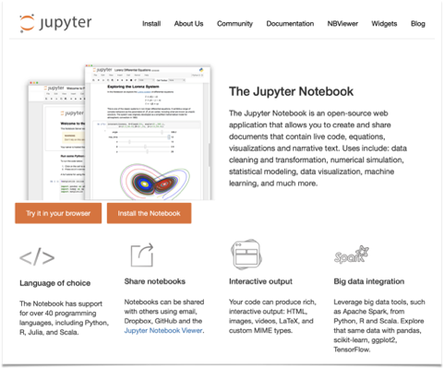

Data Analysis |
JupyterLab
https://github.com/jupyterlab
http://jupyter.org
https://www.zdnet.com/article/can-data-science-notebooks-get-real-jupyter-lab-releases-to-users/

Slide 18
Pandas | Pseudo-coding
How do I think about pseudo-coding for data analysis?
Remember, good pseudo-coding (aka Structured English) should identify & detail the functionality of your work (modules), the relationships of functionalities (not unlike how objects call each others), and most of all represents a logical process suited for both humans to follow and with sufficient details that computers can execute.
First step towards good code and better documentation.

Slide 19
Pandas | Analysis Design
You can think about an analysis as a series of dataset transformations
You might filter out rows based on conditions
You might create new columns
You might aggregate or collapse by groups
You might join two (or more) datasets together

Slide 20
 |  | Description | example
Series | 1 | 1D labeled homogeneous array, sizeimmutable. | #import the pandas import pandas as pd import numpy as np data = np.array(['a','b','c','d']) s = pd.Series(data) print s
Data Frames | 2 | General 2D labeled, size-mutable tabular structure with potentially heterogeneously typed columns. | import pandas as pd data = [1,2,3,4,5] df = pd.DataFrame(data) print df
Panel | 3 | General 3D labeled, size-mutable array. | # creating an empty panel import pandas as pd import numpy as np data = np.random.rand(2,4,5) p = pd.Panel(data) print p

Slide 21
Data Analysis | Analysis Breakout
Using your dataset, answer these questions:
What is the maximum donation in the data?
What is the most common occupation of people who donate this amount?
In what zip code do the most people in part (2) live?

Slide 22
Boolean Selection | some demos
data = pd.Series([1,2,4,6,0,85,45,7,53,321,4,32,2355,6]) | # Let’s experiment with this series
data[data < 10] | # are there values < 10?
data[(data < 10) & (data > 5)] | # how ‘bout a range with keywords
data[data < 10][data > 5] | # same result but “chained” >>> data[(data < 10) & (data > 5)] 3 6 7 7 dtype: int64 >>> data[data < 10][data > 5] 3 6 7 7 dtype: int64
# using booleans as counter: (data > 5).sum() | # True = 1; False = 0
Notes:
data[data < 10 and data > 5] fails

Slide 23
Slice and mutate | by index
Slicing & Manipulating
d5 = data.head().copy() | # make a copy … for safety!
d6 = data.head(70).copy() | # specify the size of the head (ceiling, e.g., up to 70)
data[0:10:2] | $ standard slicing - [start:end (exclusive):step]
data[0] = 10000 | # value replacement
d5_6 = pd.concat([d5, d6])

Slide 24
Check content | quick test for series
any and all tests for series
data[data < 10].any() | # true
data[data < 10].all() | # false
(data > 10000).any() | # Alternatives … false
(data > 0).all() | # false

Slide 25
Stats | quick descriptive stats for series
len(data)
data.mean() data.mode() data.median() data.count() data.std() data.unique() | # can get individual “measures of # central tendency … or use # describe() for the whole thing! >>> data.describe() count 16.000000 mean 640.312500 std 2496.070718 min 0.000000 25% 2.000000 50% 4.000000 75% 16.500000 max 10000.000000 dtype: float64
data.value_counts() | # super useful … experiment
data.shape | # note that this is an attribute, # not a method.

Slide 26
Index | lookup methods
data[10] | # by single index names
data[ [10,20] ] | # by multiple index names
 | # if the index is not numeric, pandas interprets numbers as row number
d5.iloc[ [0,3] ] | # lookup by index location “dict style[]”
data.index = range(100, len(data) + 100) | # set new index names
data.loc[ [100, 103] ] | # we can use .loc to call by index names
data.iget( [0,3] ), data.ix( [0,3] ) | # Depreciated - don’t use, ‘k?

Slide 27
Reindexing and combining | Fill in values
data.index = New_Index | # overwrite the existing index
new_data = data.reindex([0,2,15,21]) | # slide out rows and use their indices; missing values get “NaN”
data.reindex([0,2,15,21], fill_value=0) | # specify the missing values

Slide 28
Missing data | Fill in values
combo.reindex([0,2,15,21], fill_value=0) | # set fill value
new_combo.fillna(0) | # fill those NaNs!
Forward and backward fill - guess at missing values - common in practice
new_combo.ffill() | # take forward fills …
new_combo.bfill() | # take backward fills
new_combination.interpolate() | # fills missing values with linear interpolation *Note! There are several important techniques for missing values.

Slide 29
Mapping methods
s1 = pd.Series([‘1’, ‘3’])
s1 = s1.astype(int) | # what does this do?
s1.map(lambda x: x**2) | # pass a series to a lambda function
s1.map({‘1’:2, ‘2’:3, ‘3’: 12}) | # basic mapping with a dictionary

Slide 30
DataFrames | create and mutate
pd.DataFrame([upcase, lcase]) | # make a DataFrame from a series
pd.DataFrame({‘lowercase’: class, ‘uppercase’:upcase}) | # can pass column names
letters.columns = [‘LowerCase’, ‘UpperCase’] | # explicitly set the columns
letters.index = lcase | # change the indices
letters.sort(‘Number’), letters.sort() | # sort by column or by index
letters[ [‘LowerCase’, ‘UpperCase’] ] | # slide columns by name

Slide 31
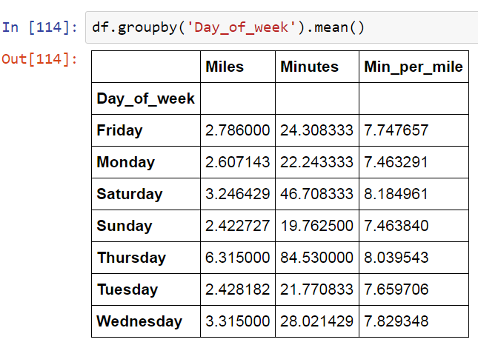
DataFrames | groupby
Viewing your data by a category can yield critical insights

Slide 32
Agenda
Course Schedule Project 2 - Project Team Coordination (10 minutes) Data Exploration and Analysis Project 2 - Team Discussions (as time allows)

Slide 33
=
With the time left in the course, it is critical you start your project this week
Pick a time to meet next
Exchange contact information
Establish a communication plan. Email, text, both?
Give everyone “something to do” before you meet again.

Slide 34



Good luck with your projects!
Your presentations focus on your
communication of your project, not the tech notes.
がんばろう！
¡Buena suerte!
حظا سعيدا!
सौभाग्य!
Удачи!
祝好运！
Viel Glück!
اچھی قسمت!
ਖੁਸ਼ਕਿਸਮਤੀ!
સારા નસીબ!

